Slide 1
Non-Recursive Predictive Parser
Rakib Mahmud

Slide 2
Non-Recursive Predictive Parser
Non-recursive predictive parser is also known as LL(1) parser
The first L stands for scanning the input from left to right.
The second L stands for producing a leftmost derivation.
1 means at a time 1 symbol will be read.
To make this parsing table is need to construct.
Size of this parsing table differs from grammar to grammar.

Slide 3
LL(1) parser
input
LL(1) parsing Algorithm
Output (Parse tree)
$
LL(1) parsing table
Stack

Slide 4
Prime Requirement of LL(1) Parser
The following are the prime requirements for the LL(1) parser:
The grammar must have no ambiguity, no non-determinism and no left recursion.
FIRST() & FOLLOW()
Parsing Table
Stack Implementation
Parse Tree

Slide 5
LL(1) Parsing Table
A two-dimensional array M[A,a]
Each row is a non-terminal symbol
Each column is a terminal symbol or the special symbol $
Each entry holds a production rule.
 | a | b | $
S | S → aBa
B | B → ε | B → bB

Slide 6

Rules for creating LL(1) Parsing Table
Add A → $α$ under M[A,a] where a$∈$ First($α$)
Add A → $α$ under M[A,a] where a$∈$ Follow(A) if First($α$) contain ε

Slide 7
LL(1) Parser – Parser Actions
The symbol at the top of the stack (say X) and the current symbol in the input string (say a) determine the parser action.
There are four possible parser actions.
If (X = $, a = $ ) parser halts (successful completion)
If X= a (but not $) parser pops X from the stack, and moves the next symbol in the input buffer.
If X is a non-terminal
Parser looks at the parsing table entry M[X, a].
If M[X, a] holds a production rule X→Y₁Y₂...Y_{k}, it pops X from the stack and pushes Y_{k},Y_{k-1},...,Y₁ into the stack.
The parser also outputs the production rule X→Y₁Y₂...Y_{k} to represent a step of the derivation.

Slide 8
LL(1) Parser – Parser Actions
None of the above : error
All empty entries in the parsing table are errors.
If X is a terminal symbol different from a, this is also an error case.

Slide 9
Ex1:
E → TE’
E’ → 𝜀 | + TE’
T → FT’
T’ → 𝜀 | *FT’
F → id | (E)
Construct the parse table for the LL(1) grammar and parse the input string id+id$
Solution:
It is not ambiguous, left recursive, non-deterministic. So no need to eliminate ambiguity, left recursion or non-determinism.

Slide 10
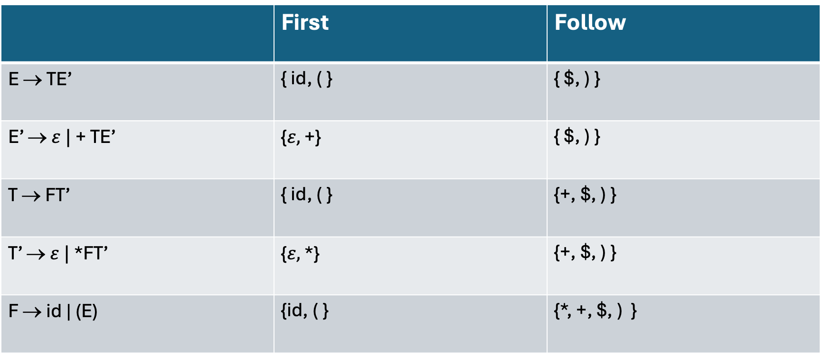
Finding First and Follow
 | First | Follow
E → TE’ | { id, ( } | { $, ) }
E’ →$ε |$ + TE’ | {$ε,$ +} | { $, ) }
T → FT’ | { id, ( } | {+, $, ) }
T’ → $ε |$ *FT’ | {$ε,$ *} | {+, $, ) }
F → id | (E) | {id, ( } | {*, +, $, ) }

Slide 11
Creating LL(1) Parsing Table
M | id | + | * | ( | ) | $
E | E → TE’ |  |  | E → TE’
E’ |  | E’ → +TE’ |  |  | E’ → ε | E’ → ε
T | T → FT’ |  |  | T → FT’
T’ |  | T’ → ε | T’ → *FT’ |  | T’ → ε | T’ → ε
F | F → id |  |  | F → (E)

Slide 12
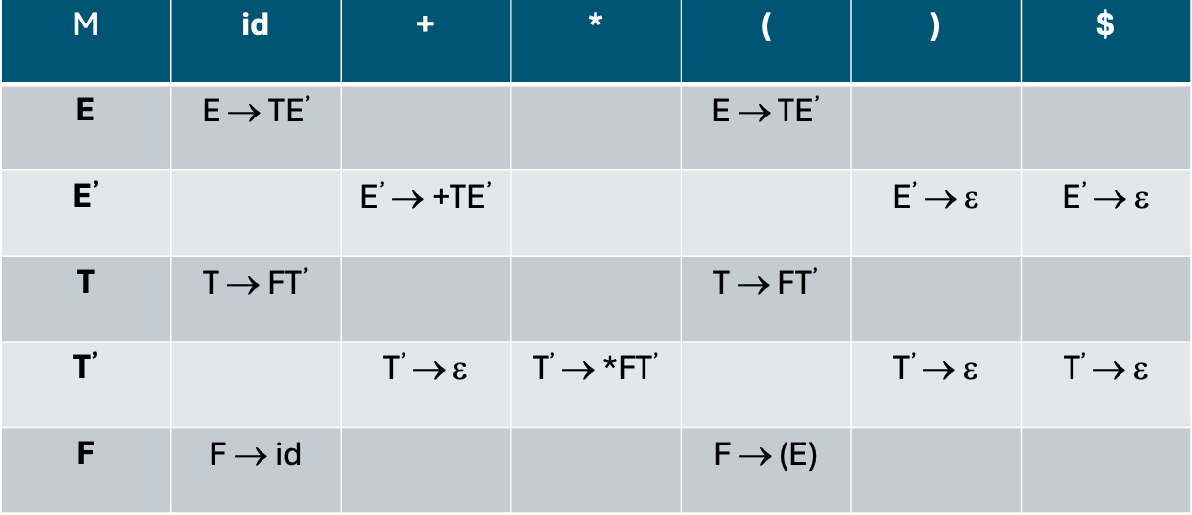
Stack Implementation
stack input output
$E id+id$ E → TE’
$E’T id+id$ T → FT’
$E’ T’F id+id$ F → id
$ E’ T’id id+id$ Pop
$ E’ T’ +id$ T’ → ε
$ E’ +id$ E’ → +TE’
$ E’ T+ +id$ Pop
$ E’ T id$ T → FT’
$ E’ T’ F id$ F → id
$ E’ T’id id$ Pop
$ E’ T’ $ T’ → ε
$ E’ $ E’ → ε
$ $ accept

Slide 13
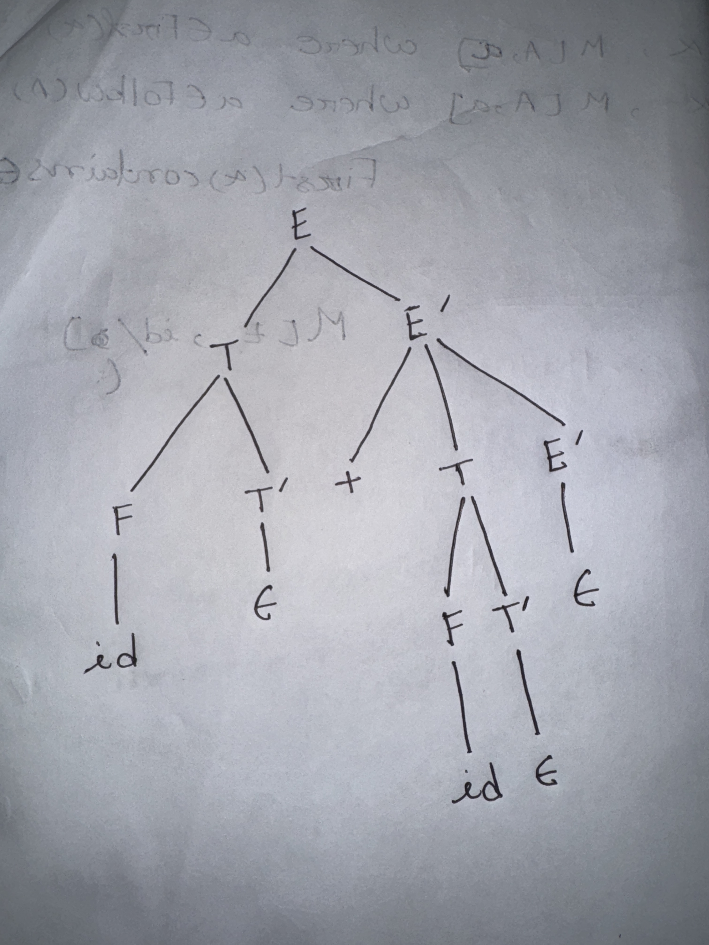
Creating Parse Tree
stack input output
$E id+id$ E → TE’
$E’T id+id$ T → FT’
$E’ T’F id+id$ F → id
$ E’ T’id id+id$ Pop
$ E’ T’ +id$ T’ → ε
$ E’ +id$ E’ → +TE’
$ E’ T+ +id$ Pop
$ E’ T id$ T → FT’
$ E’ T’ F id$ F → id
$ E’ T’id id$ Pop
$ E’ T’ $ T’ → ε
$ E’ $ E’ → ε
$ $ accept
Parse Tree

Slide 14
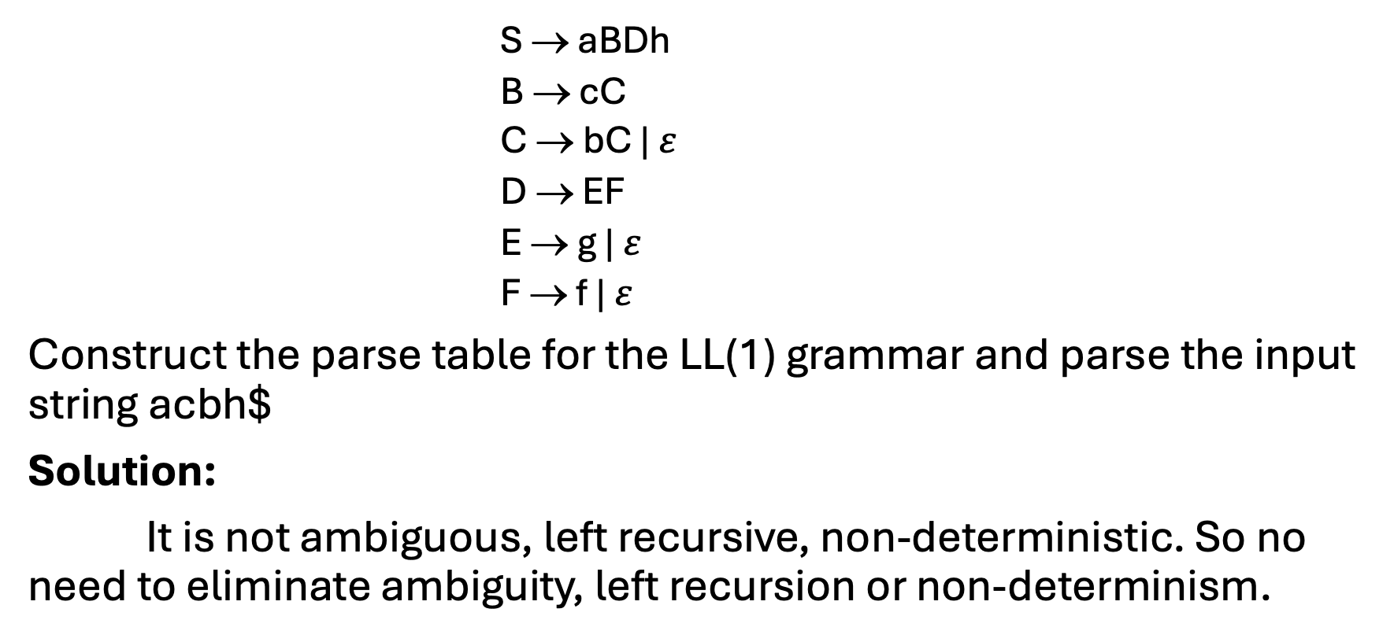
Ex2:
S → aBDh
B → cC
C → bC | $ε$
D → EF
E → g | $ε$
F → f | $ε$
Construct the parse table for the LL(1) grammar and parse the input string acbh$
Solution:
It is not ambiguous, left recursive, non-deterministic. So no need to eliminate ambiguity, left recursion or non-determinism.

Slide 15
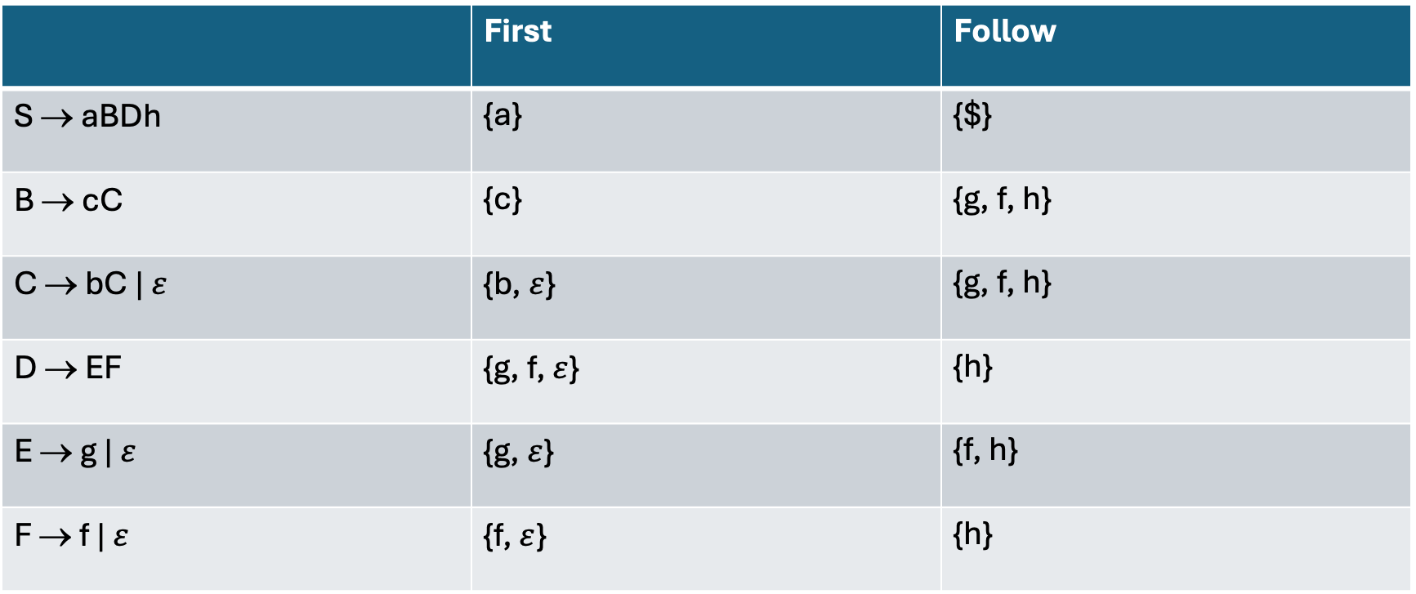
Finding First and Follow
 | First | Follow
S → aBDh | {a} | {$}
B → cC | {c} | {g, f, h}
C → bC | $ε$ | {b, $ε$} | {g, f, h}
D → EF | {g, f, $ε$} | {h}
E → g | $ε$ | {g, $ε$} | {f, h}
F → f | $ε$ | {f, $ε$} | {h}

Slide 16
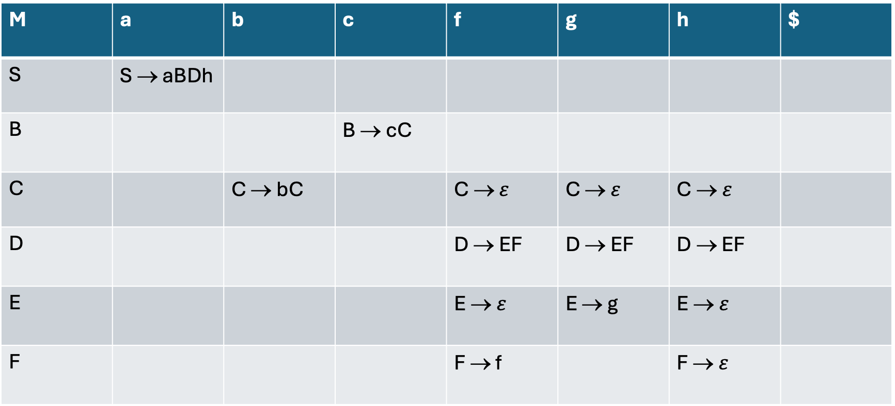
Creating LL(1) Parsing Table
M | a | b | c | f | g | h | $
S | S → aBDh
B |  |  | B → cC
C |  | C → bC |  | C → $ε$ | C → $ε$ | C → $ε$
D |  |  |  | D → EF | D → EF | D → EF
E |  |  |  | E → $ε$ | E → g | E → $ε$
F |  |  |  | F → f |  | F → $ε$

Slide 17
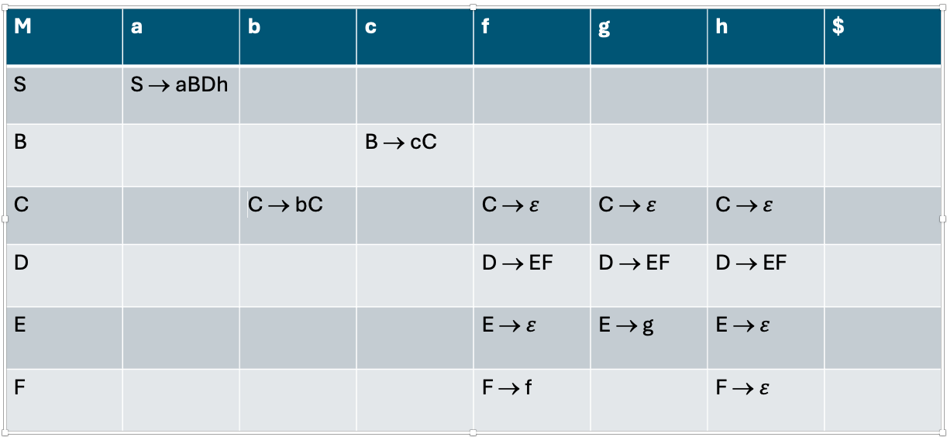
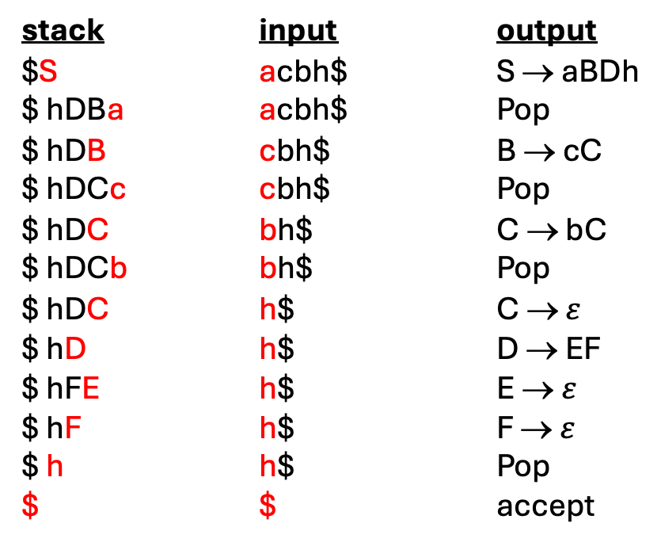
Stack Implementation
stack input output
$S acbh$ S → aBDh
$ hDBa acbh$ Pop
$ hDB cbh$ B → cC
$ hDCc cbh$ Pop
$ hDC bh$ C → bC
$ hDCb bh$ Pop
$ hDC h$ C → $ε$
$ hD h$ D → EF
$ hFE h$ E → $ε$
$ hF h$ F → $ε$
$ h h$ Pop
$ $ accept

Slide 18
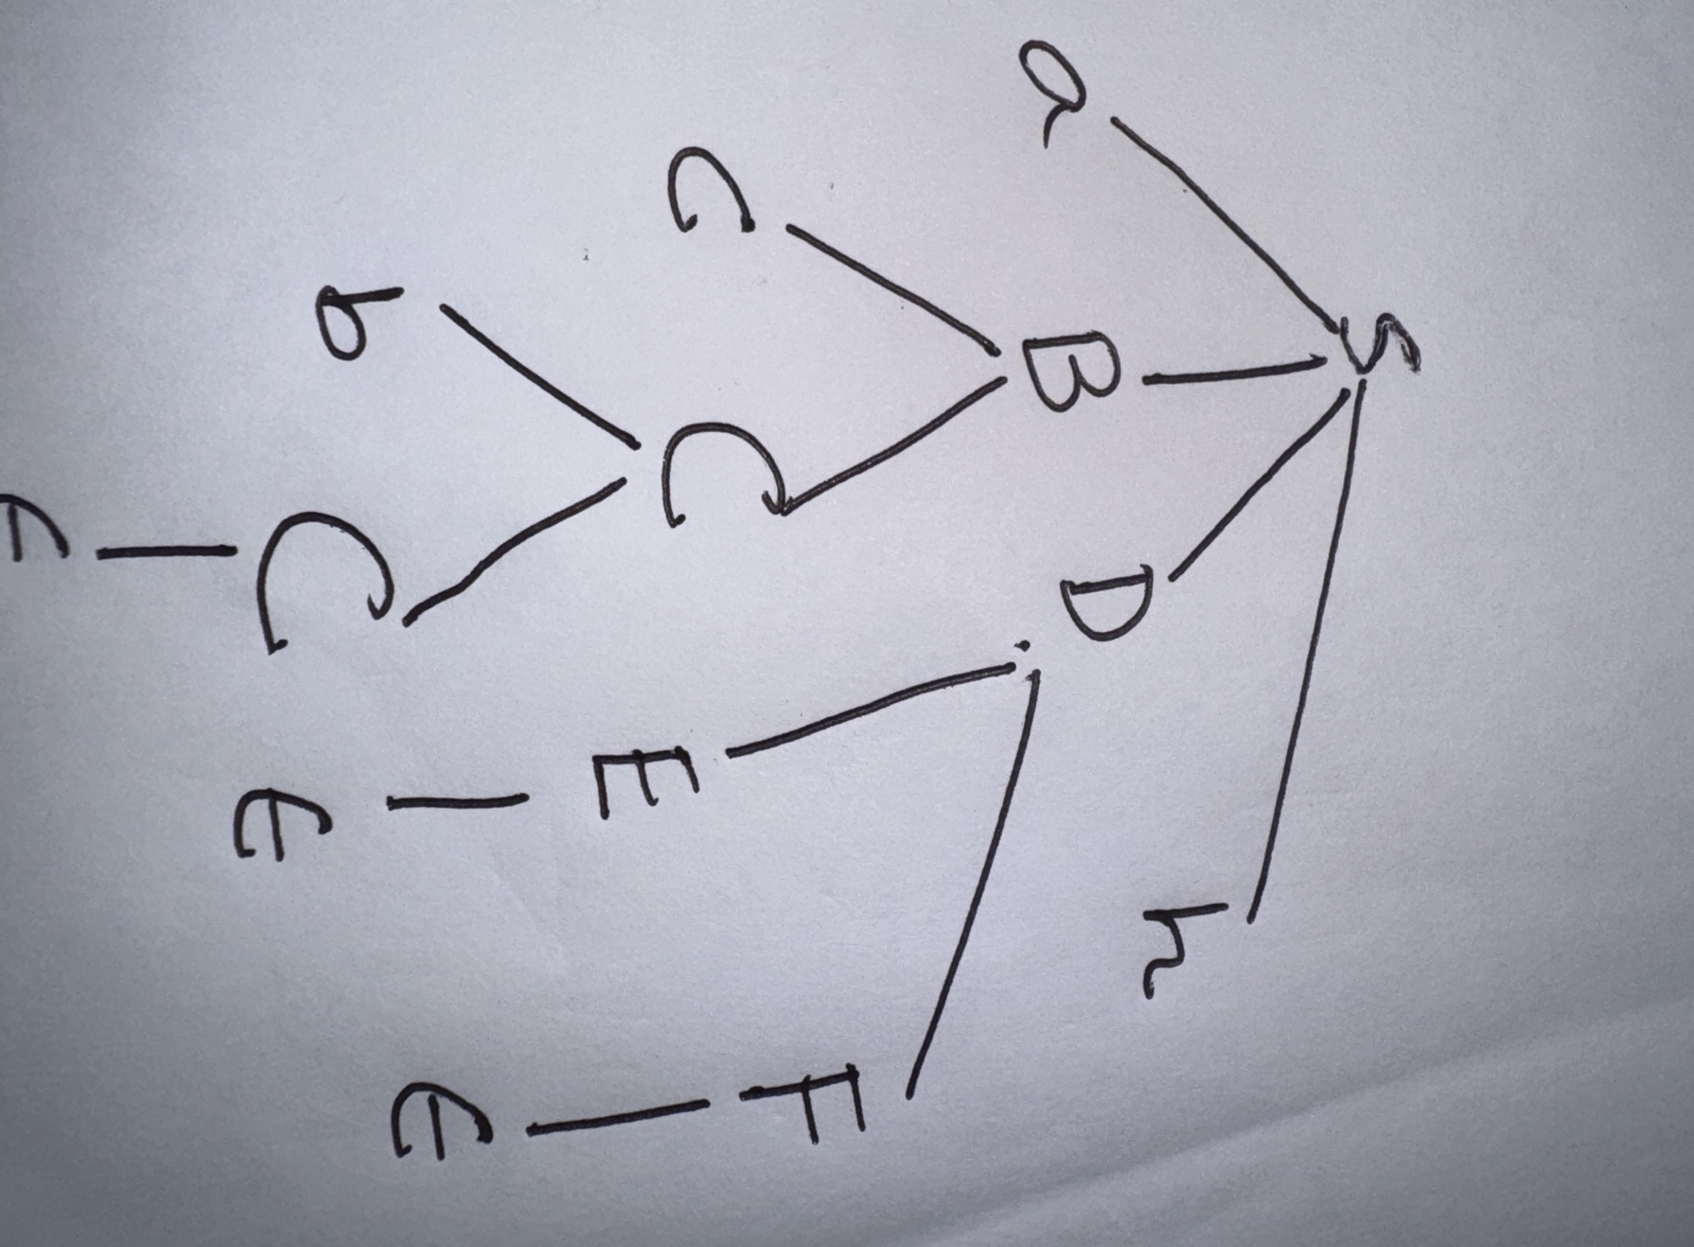
Creating Parse Tree
stack input output
$S acbh$ S → aBDh
$ hDBa acbh$ Pop
$ hDB cbh$ B → cC
$ hDCc cbh$ Pop
$ hDC bh$ C → bC
$ hDCb bh$ Pop
$ hDC h$ C → $ε$
$ hD h$ D → EF
$ hFE h$ E → $ε$
$ hF h$ F → $ε$
$ h h$ Pop
$ $ accept
Parse Tree

Slide 19
How to check given Grammar is LL(1)
The parsing table of a grammar may contain more than one production rule i.e. multiple defined. This is possible if G is left recursive or ambiguous.
In this case, we say that it is not a LL(1) grammar.
A grammar whose parsing table has no multiply-defined entries is said to be LL(1) grammar.

Slide 20
Ex1:
S → iCtSE | a
E → eS | ε
C → b
Check if this grammar is LL(1) or not
Solution:
FIRST(iCtSE) = {i}
FIRST(a) = {a}
FIRST(eS) = {e}
FIRST(ε) = {ε}
FIRST(b) = {b}
two production rules for M[E,e]. So, this grammar is not LL(1).
FOLLOW(S) = { $,e }
FOLLOW(E) = { $,e }
FOLLOW(C) = { t }
M | a | b | e | i | t | $
S | S → a |  |  | S → iCtSE
E |  |  | E → e S E → ε |  |  | E → ε
C |  | C → b

Slide 21
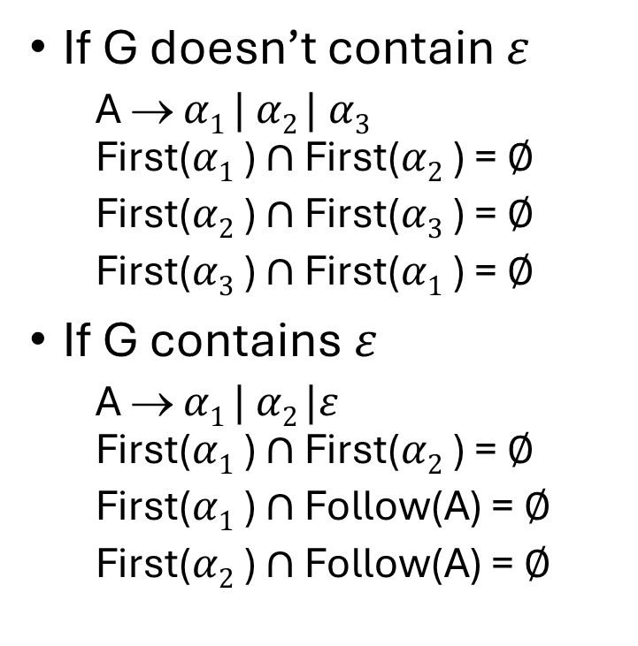
How to check given Grammar is LL(1)
If G doesn’t contain $ε$
A → $α1 |$ $α2 |$ $α3$ First($α1$) $∩$ First($α2$) = $∅$
First($α2$) $∩$ First($α3$) = $∅$
First($α3$) $∩$ First($α1$) = $∅$
If G contains $ε$
A → $α1 |$ $α2 |ε$ First($α1$) $∩$ First($α2$) = $∅$
First($α1$) $∩$ Follow(A) = $∅$
First($α2$) $∩$ Follow(A) = $∅$
✅ How to Check if a Grammar is LL(1):Remove Left Recursion & Left Factor the grammar.Compute FIRST and FOLLOW sets for all non-terminals.Construct the Predictive Parsing Table (PPT):If A → α, put it in M[A, a] for all a ∈ FIRST(α).If ε ∈ FIRST(α), also put it in M[A, b] for all b ∈ FOLLOW(A).Check for Conflicts:If any cell has more than one entry → Not LL(1).Otherwise → LL(1).

Slide 22
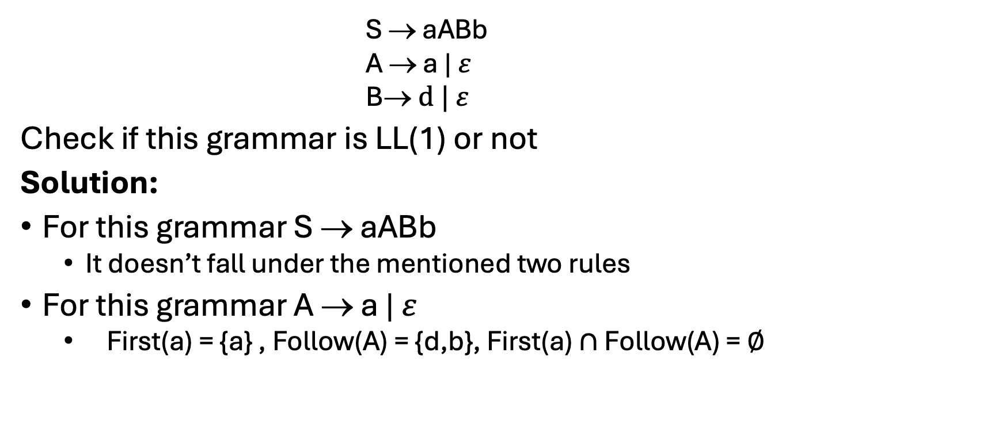
Ex1:
S → aABb
A → a | $ε$
B→$d | ε$
Check if this grammar is LL(1) or not
Solution:
For this grammar S → aABb
It doesn’t fall under the mentioned two rules
For this grammar A → a | $ε$
First(a) = {a} , Follow(A) = {d,b}, First(a) $∩$ Follow(A) = $∅$

Slide 23

Ex1: (Cont’d)
For this grammar B→$d | ε$
First(d) = {d} , Follow(B) = {b}, First(d) $∩$ Follow(B) = $∅$
So, this grammar is LL(1) grammar.

Slide 24
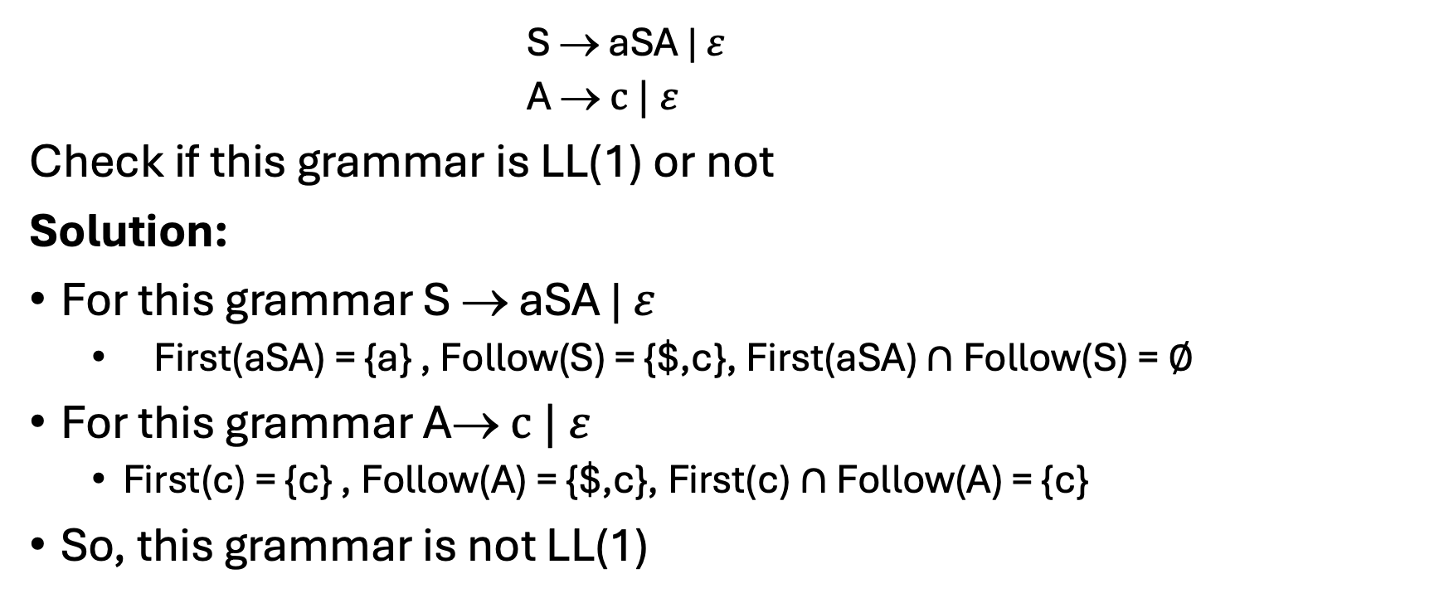
Ex2:
S → aSA | $ε$
A →$c | ε$
Check if this grammar is LL(1) or not
Solution:
For this grammar S → aSA | 𝜀
First(aSA) = {a} , Follow(S) = {$,c}, First(aSA) $∩$ Follow(S) = $∅$
For this grammar A→$c | ε$
First(c) = {c} , Follow(A) = {$,c}, First(c) $∩$ Follow(A) = {c}
So, this grammar is not LL(1)

Slide 25
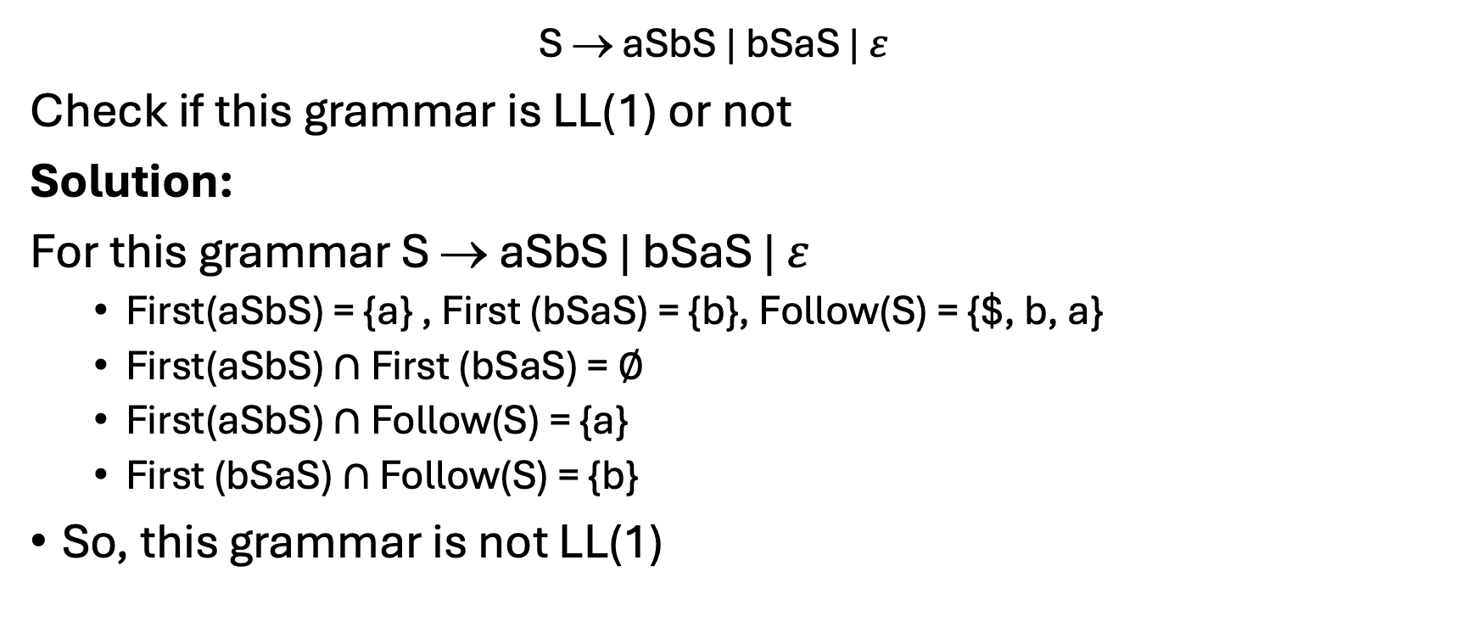
EX3:
S → aSbS | bSaS | $ε$
Check if this grammar is LL(1) or not
Solution:
For this grammar S → aSbS | bSaS | $ε$
First(aSbS) = {a} , First (bSaS) = {b}, Follow(S) = {$, b, a}
First(aSbS) $∩$ First (bSaS) = $∅$
First(aSbS) $∩$ Follow(S) = {a}
First (bSaS) $∩$ Follow(S) = {b}
So, this grammar is not LL(1)

Slide 26
Thank You

